Slide 1

E/L A02 CAREER INTELLIGENCE
ITECH3208 PROJECT DEVELOPMENT

Slide 2
Description Of the Project
First phase
- To design and test a fully working interactive course on the open-source Learning Management System
- To create and deploy the Career Intelligence web app, which assists learners in creating interactive CVs.
Second Phase - The development of a Career Intelligence web app that will allow learners to communicate with domain experts about career options
- To create their own interactive career interest profiles, as well as the creation of a knowledgebase structure and prototype.

Slide 3
Roles and structure of group
Team members
Vidhi Modi (30391470) – Project Manager and Scrum Master
Rajan Patel (30391474) – Process Analyst and Change Manager
Sajal Singh (30376237) – Developer and UX/UI Designers
Hetkumar Patel (30391427) – Operational Manager and Analyst

Slide 4

Clients
1.Marketa Mojzisova, E/L Programme Manager
2.Anirudh Phadke, Head of Digital Content
3.Supriyo Chaudhuri, Chief Learning Officer

Slide 5

Technical aspects of the project
GitHub – Project Management
MS-teams- Team meeting and client meeting
Figma – UX designing Coding
CSS
JAVA
H5P
Html
Software testing
Webload

Slide 6
Sprint 1
Users can log in through Employability. Life-course id on Career Intelligence website.
If the user is not a member, then they must register as a new user.
The user must provide the details of themselves that will be saved in the database.
Users can see the templates already available to make their CV.

Slide 7
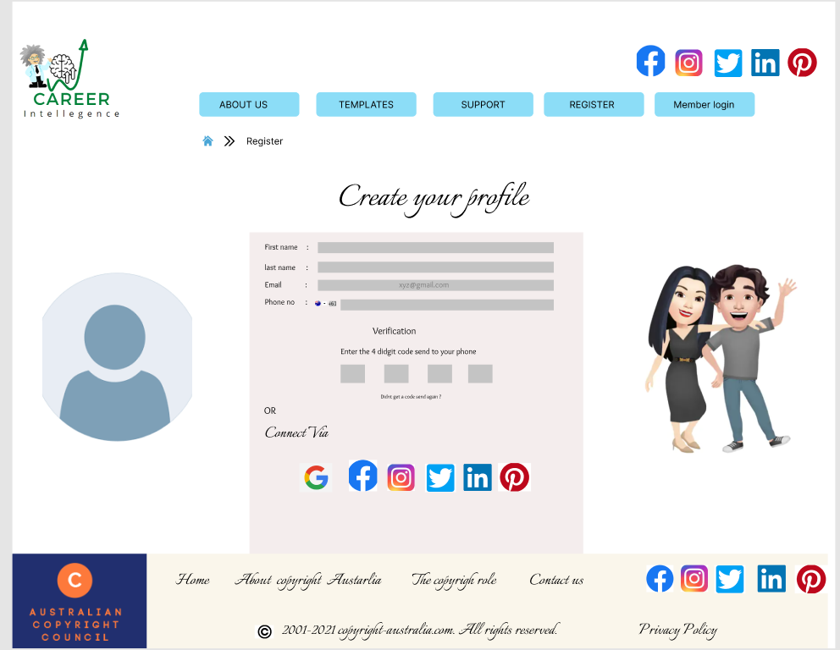
Product backlog 1: High Priority US 1: AS a user I want to register as a new user.
Justification - High Priority
Personalize yourself Tailor the experience of web content and accessories like a template
It allows the user to develop the cv interactively.

Slide 8
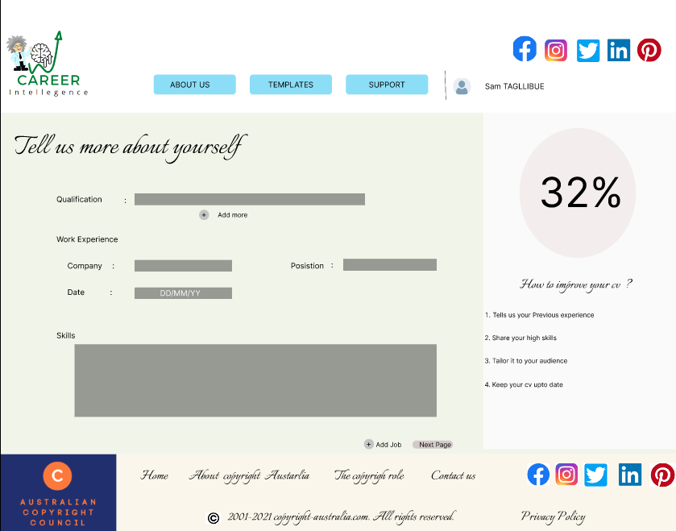
Product Backlog 2 :
US2: As a user, I want to provide the details that would help me to make my CV.
Justification Knowing what skills and experience and how qualified are you as it’s the main aspect to create a cv.

Slide 9
Link to Prototype
Https://www.figma.com/proto/6y7bjLNzaXEJKTSccG8Dxq/Untitled?node-id=2%3A4&scaling=scale-down&page-id=0%3A1&starting-point-node-id=2%3A4

Slide 10
Critical Reflection
What went well?
What went wrong?
Well, all the participants were contributed towards making presentation slides
In addition, group members helped each other equally and managed time to finish allocated on time.
The client liked the ideas suggested by our group.
The user stories and wireframes were developed as per the client’s requirements.
Well, we had some sort of doubts regarding the project description, and we understood some of the aspects.
While creating user stories and wireframes, it was a bit difficult as it took extra time to be done.

Slide 11
Feedback from Marketa
-Conduct a more in-depth analysis of similar sites.
-Demonstrates how to add some new concepts to our site to make it more user-friendly.
-Refers us to Anirudh, the project's technical client, for technical inquiries.
Feedback from Anirudh When building wireframes, think about all the options and keep our end user's requirements in mind
- Visit H5P.org and Moddle.org for more ideas

Slide 12

Any questions?

Slide 13

Thank You

